Slide 1
DIGITAL COMPANION
An Engineering Project in Community Service
Final Review
Visual help for the impaired community

Slide 2
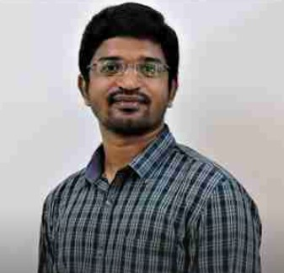
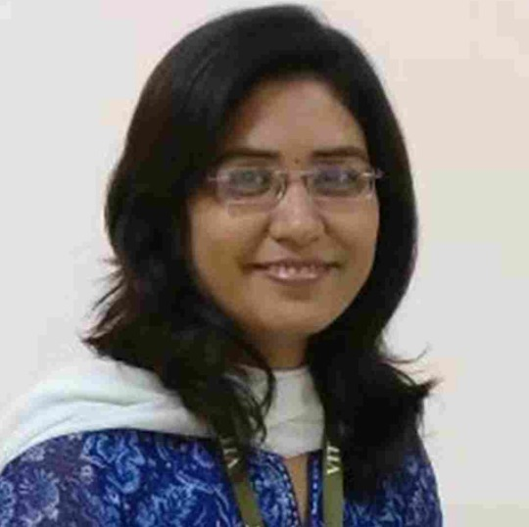
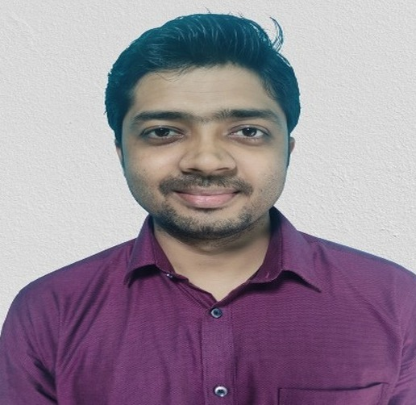
GUIDE AND REVIEWERS
Project Guide :
Dr. G L BALAJI
Assistant Professor
SASL
Project Reviewer 1 :
Dr. Kanchan Lata Kashyap Senior Assistant Professor
SCSE
Project Reviewer 2 :
Dr. Abhijit Sarkar
Assistant Professor
SASL

Slide 3
Team Members
19BAI10025
Jigyasa Bisht
19BAI10054
Vanshika Sabhani
19BAI10077
Rashmi Rawat
19BCE10274
Sanjana Singh
19BCE10283
Rachita Jha
19BCE10456
Divya Mathew
19BCG10075
Nandini Joshi
19BOE10080
Anjali Patel

Slide 4
Problem Defining
Motivation
Introduction
Objective

Slide 5
INTRODUCTION
Digital Companion: Email assistance
System helping in via e-mail communication
Voice Interactions:
Each command is completely voice based command
Better Communication: Two-way speech-text makes it easier for user to use and interact

Slide 6
PROBLEM DEFINITION
Our problems defining is based on two major aspects:
Easy to understand and use: Making is simple for user to understand and use the system without any inconvenience
Accessibility: Making electronic mailing system accessible for everyone

Slide 7
OBJECTIVE AND MOTIVATION
The primary motivation was to help visually imapired people to overcome the gap and help them with smooth working interaction via email. We aim to achieve it with the help of following objectives:
Means of Communication: Making emails a means of communication for visually impared people
Voice based mailing system: Creating a system based on voice for easy usage
Low-cost System: Low cost or no cost makes it affordable for everyone

Slide 8
Limitations
Novelty
Existing Work/
Literature Review

Slide 9
EXISTING WORK
The existing system makes use of Speech Recognition, Interactive Voice Response, and Mouse click events.
Another proposed model relies on the voice-command-
based system which is primarily based on the speech-to-
text command.
Another system eliminates the use of IVR technology that uses Screen Reader and Braille Keyboard. This system uses Gmail as the host server, it is purely a voice-based driven by proper feedback from the system.

Slide 10
EXISTING WORK LIMITATIONS
The user cannot make use of the mouse pointer as it is completely inconvenient if the pointer location cannot be tracked.
It is also seen that only a few languages are used in the system. There should be other languages so that the user becomes more comfortable. Beside screen readers cannot spell technical and biological terms.
A screen reader cannot survey the entirety of a screen as a visual user may do. They can quickly realize a web page and realize how a page is been organized.

Slide 11
NOVELTY
We have tried to introduced a new components in our project which is different from the existing models that we have described so far.
In all the existing systems security of the user is one of the major concerns. We have tried to resolve this problem by using face detection and recognition ensures the complete security of the user.
We have also eliminated the use of the mouse
Our proposed system focuses on reliability and user friendly and is very helpful for the visually impaired.

Slide 12
HARDWARE REQUIREMENTS
Recommended hardware specifications are:
CPU - Intel Core i5 8th Generation
GPU - NVIDIA GeForce GTX 940 or higher.
RAM - 8 GB memory and up Stable internet connection (minimum 5mbps download)
Microphone : Inbuilt in system
Speaker : Inbuilt in system

Slide 13
SOFTWARE REQUIREMENTS
The application is based upon the python language, which is high-level programming language easy to use, and with the python.
Operating System : Windows 10
Coding Language : Python 3
IDE : Pycharm, Jupyter Notebook
Front End : Tkinter
Back End : Python

Slide 14
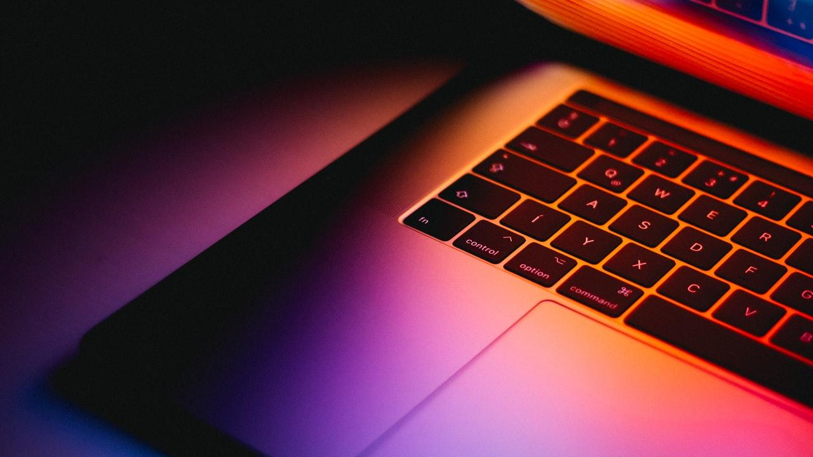
SYSTEM ARCHITECTURE

Slide 15
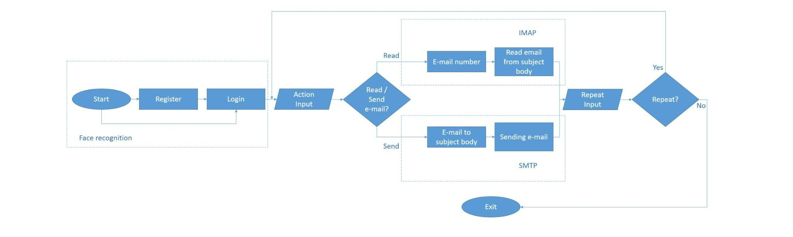

Slide 16
Email
Face Recognition
Frameworks
Speech Recognition

Slide 17
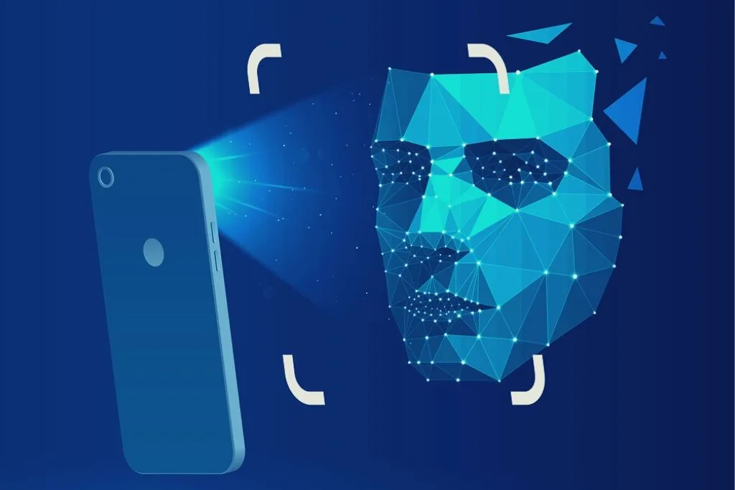
FACIAL RECOGNITION
CONTRIBUTORS:
Sanjana Singh
Vanshika Sabhani

Slide 18


MODULES USED
DLIB
Dlib will be used for facial landmark detection.The pre-trained facial landmark detector inside the dlib library is used to estimate the location of 68 (x, y)-coordinates that map to facial structures on the face for the actual recognition process.
FACE-RECOGNITION
Python provides face_recognition API which is built through dlib’s face recognition algorithms. This face_recognition API allows us to implement face detection and recognition.
OPENCV
OpenCV is an image and video processing library and is used for image and video analysis

Slide 19
PROCESS
FACE DETECTION - To recognise a face, it is first important that we detect/locate a face in an image/video. We extract a human face and then move on to the next step.
FEATURE EXTRACTION USING FACE EMBEDDING - The next step is to extract features from a face using a face embedding model. A face embedding is a vector that represents the features extracted from the face and we can use these vectors to recognise faces. That face embedding for the same face may be really close in the vector space, whereas the face embeddings of two different faces may be really far away. We get a face embedding after passing the image through a face embedding model.
FACE RECOGNITION - We have face embedding for each face in the system. Whenever we pass a new face to the system, it calculates its face embedding and compares it with the ones we already have. The face is recognised, if its face embedding closely matches any other face embedding in the database.

Slide 20
PURPOSE
One of the key feature of our module is to enhance the security and privacy of the user.
Facial recognition need fewer human resources than any other security measure such as, fingerprinting.
This system does not require any physical contact or direct human interactions .
With the use of this system the user no longer has to remember the lengthy password.

Slide 21
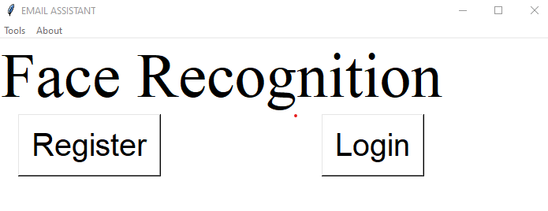
WORKING
REGISTER - This button allows the user to enter name and clicks a picture of face by turning on the camera of system.It store the information about human face structure, i.e face embedding/encoding. WORKFLOW DIAGRAM
LOGIN - This button recognize the person by comparing the new face embeddings with the stored one. WORKFLOW DIAGRAM
Notes:
Here we will again create person’s encodings from the camera frame. Then, we will match the new encodings with stored encodings from the pickle file. The new encodings of same person will be close to its encodings in the vector space. And hence we will be able to recognize the person.

Slide 22
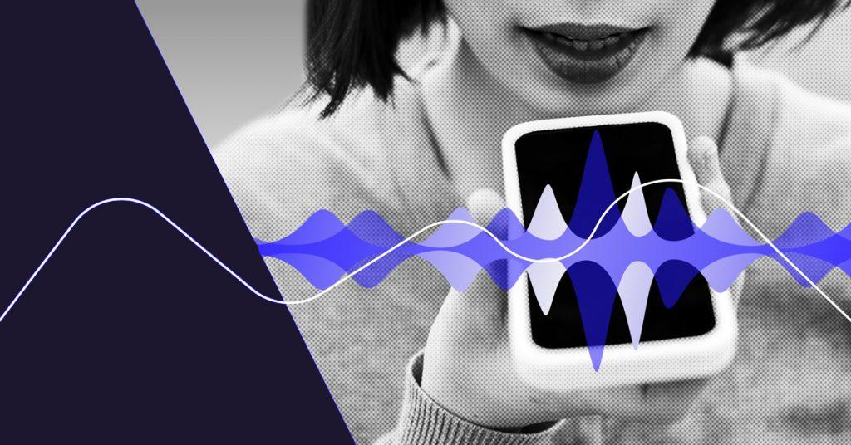
SPEECH RECOGNITION
CONTRIBUTORS:
Anjali Patel
Rachita Jha
Rashmi Rawat

Slide 23
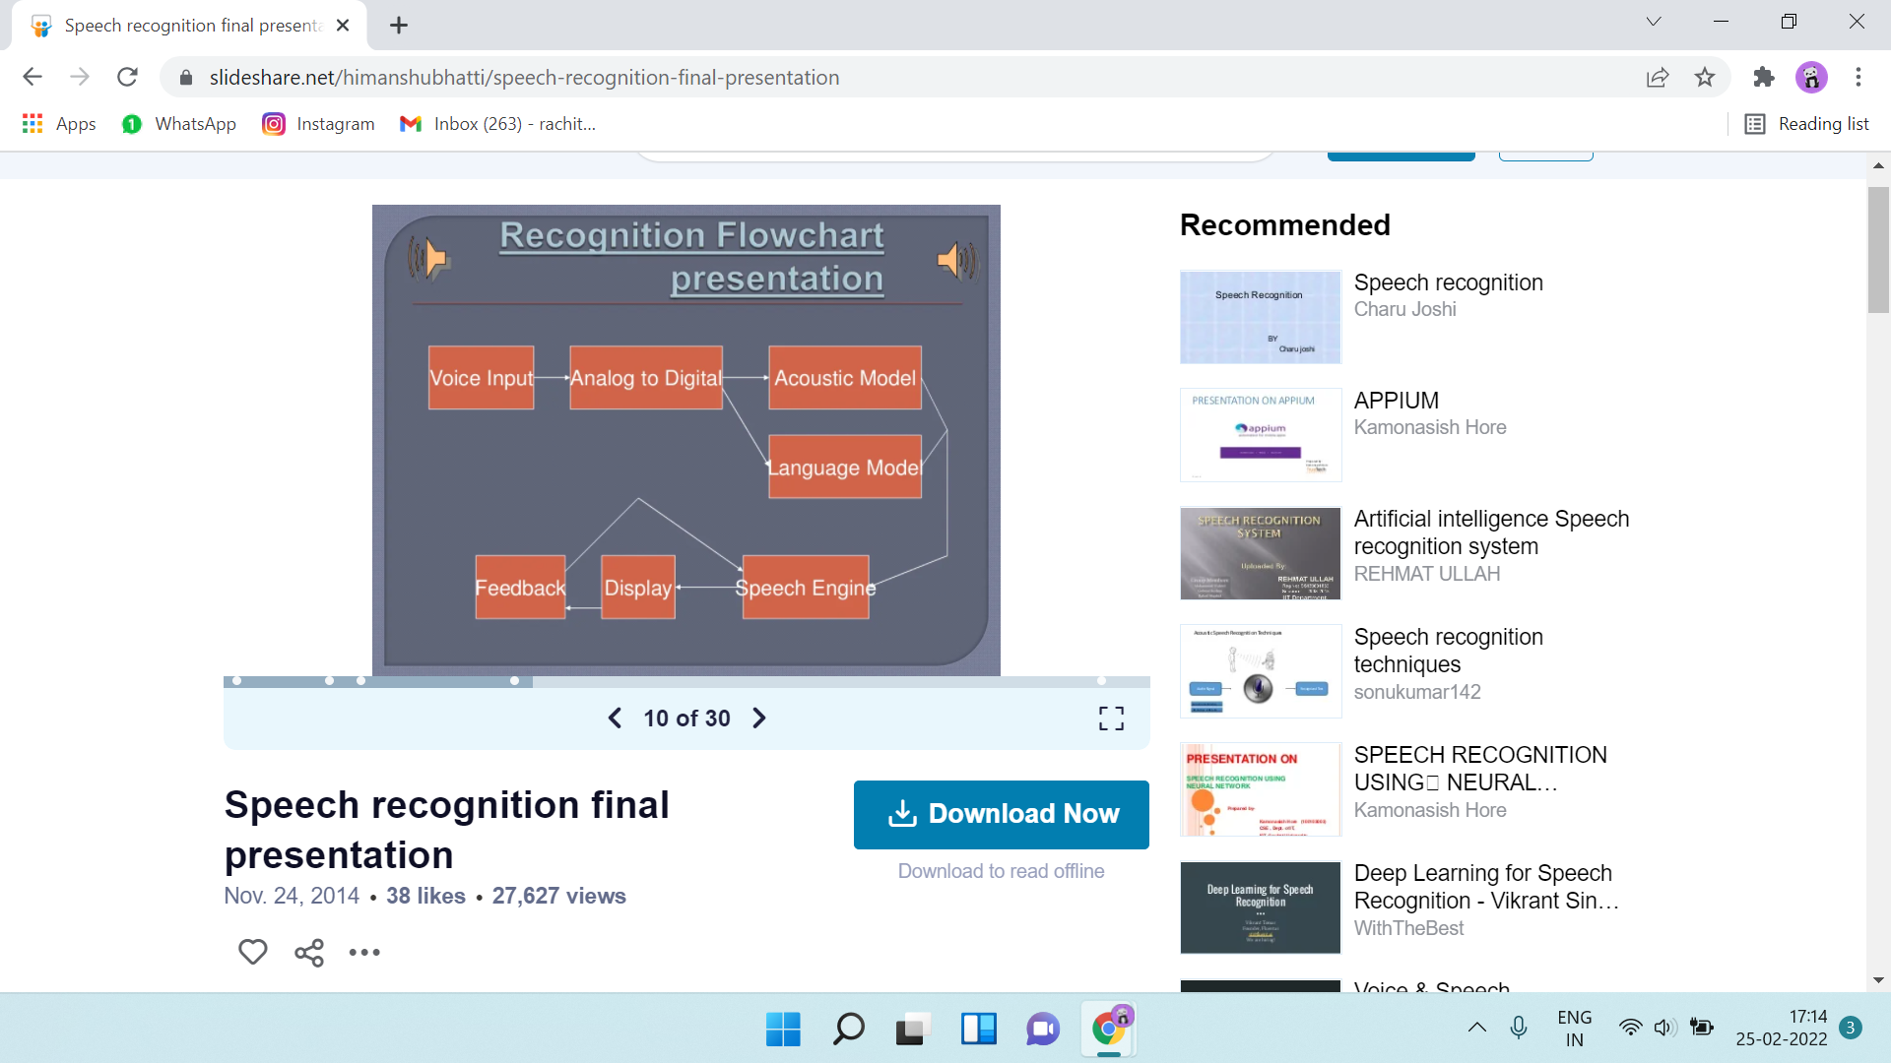
WORKING
Step- 1: User Input
Step 2: Digitization
Step 3: Phonetic Breakdown
Step 4: Statistical Modelling
Step 5: Matching
Notes:
Nandini

Slide 24
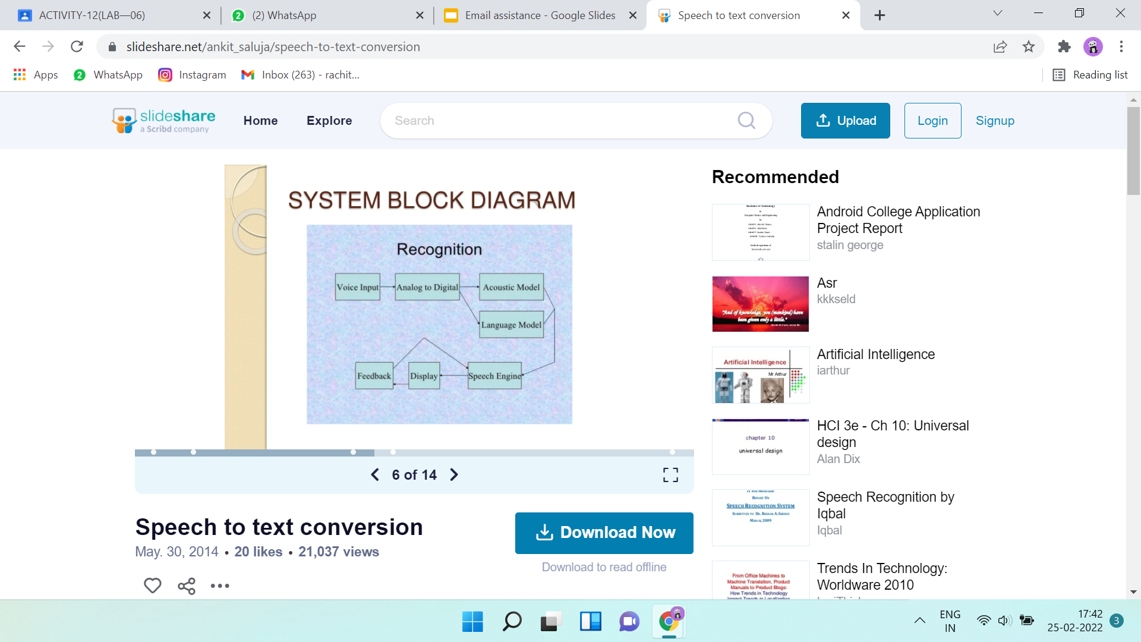
SPEECH TO TEXT
Acoustic Model
Language Model
Speech Engine

Slide 25
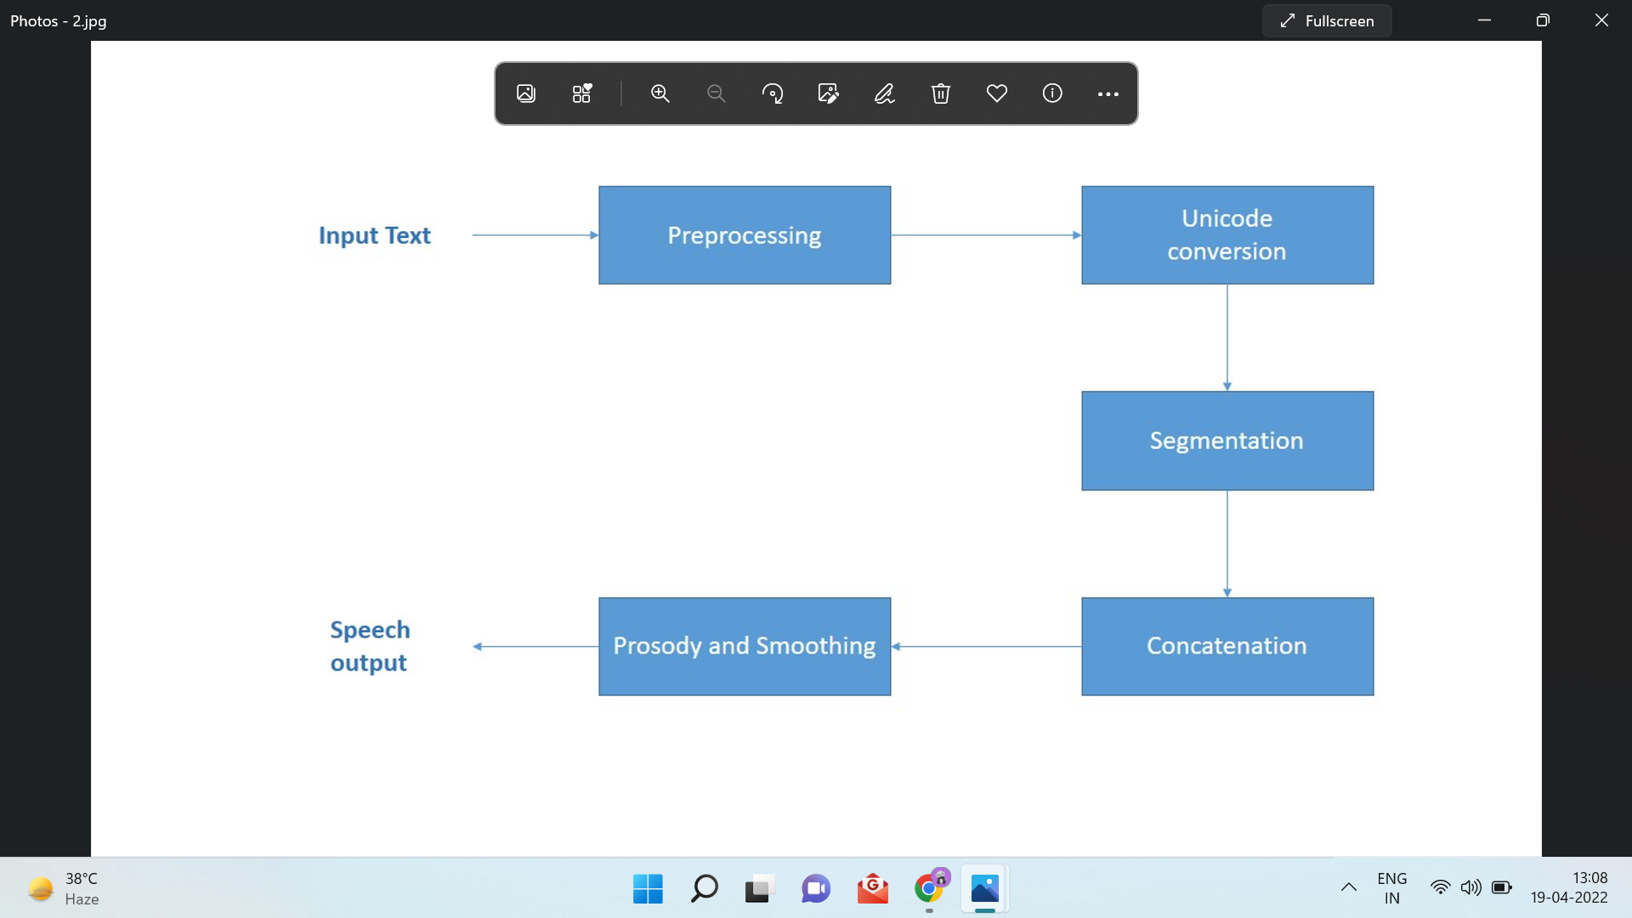
TEXT TO SPEECH
Pre- processing of the input text
Conversion to unicode
Pre-processed text is used to identify the fonts of input text
Encoded text is segmented into syllables
Mapped with pre- recorded syllable sound files

Slide 26
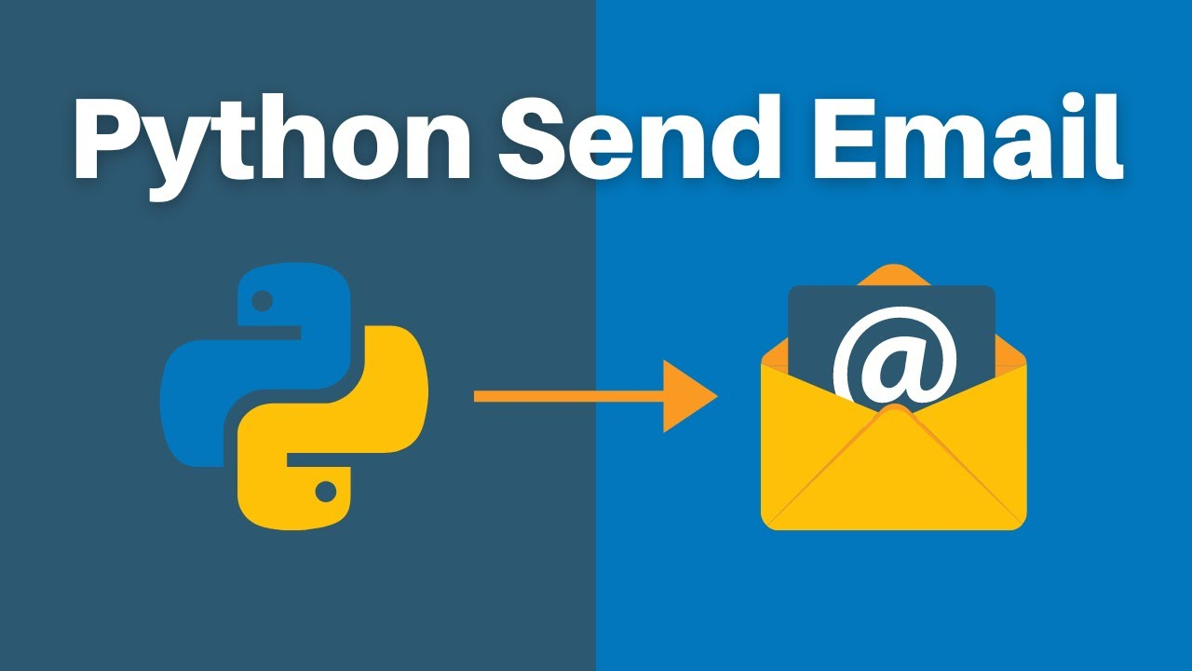
E-mail : Sending & Receiving
CONTRIBUTORS :
Jigyasa Bisht
Divya Mathew

Slide 27

MODULES USED
Smtplib
The smtplib is a Python library for sending emails using the Simple Mail Transfer Protocol (SMTP). We use the following command to install smtplib to our python interpreter :- !pip install smptlib.
Imaplib
The imaplib is a Python library that describes how to access messages in an email mailbox. We use the following command to install imaplib to our python interpreter :- pip install imaplib.

Slide 28
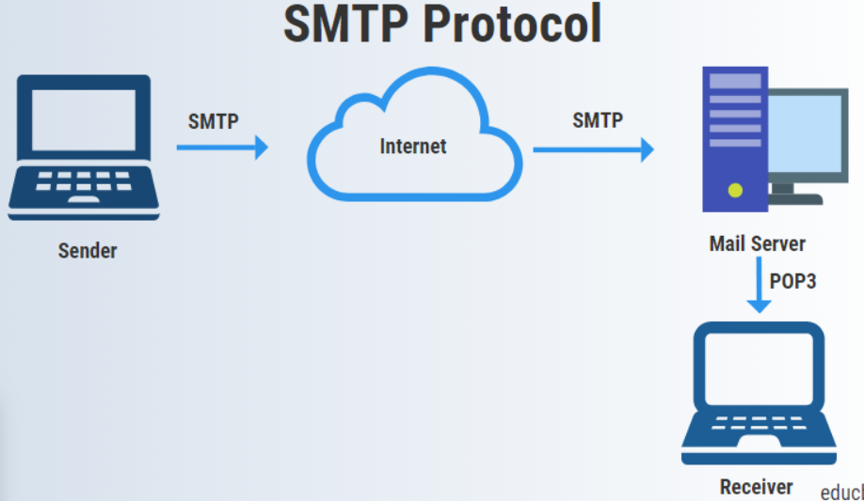
SMTP : Simple Mail Transfer Protocol
Sending mails: SMTP is a protocol used for sending email. When we write an email in gmail and hit send button, the email travels from your computer to your email SMTP server using SMTP protocol. The SMTP server will send the message to the recipient email server using SMTP. Then the email will stay on the recipient's email server until the recipient logs into the email account.

Slide 29
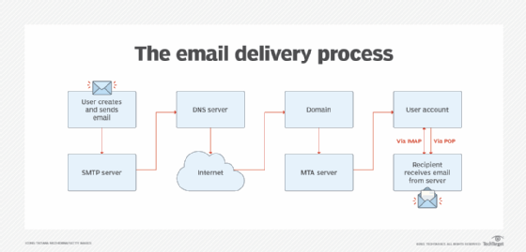
IMAP
IMAP server : imap.<name of service>.com
We’re going to connect to an email account, list all of the available folders in the mailbox. You’ll be able to follow along as we walk through the protocol, as long as you have access to a terminal, the openssl command-line utility, and an email account that supports IMAP (including Gmail).

Slide 30
IMAP (Internet Message Access Protocol )
The first thing any client needs to do is to to make a connection to the remote server on a specific port. These ports can vary because mail servers first accepted plaintext connections and later added support for secure encrypted connections
Commands: <tag> <command> [<arg1><arg2>…]
Tagging
Capabilities
Authentication
Server Responses

Slide 31
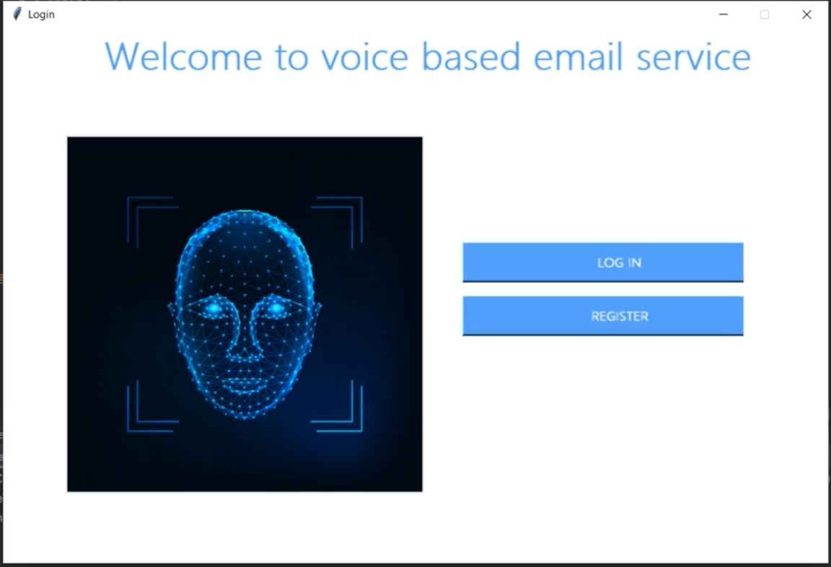
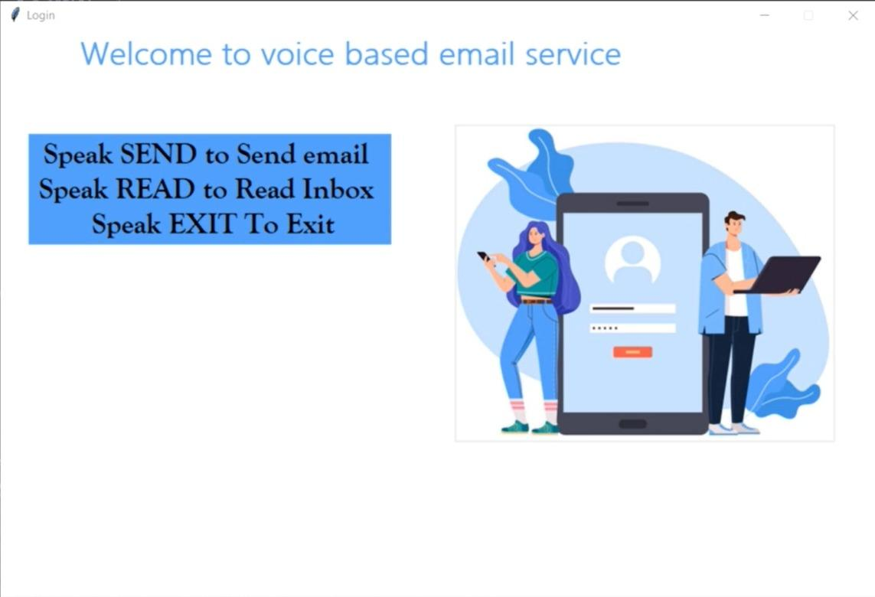
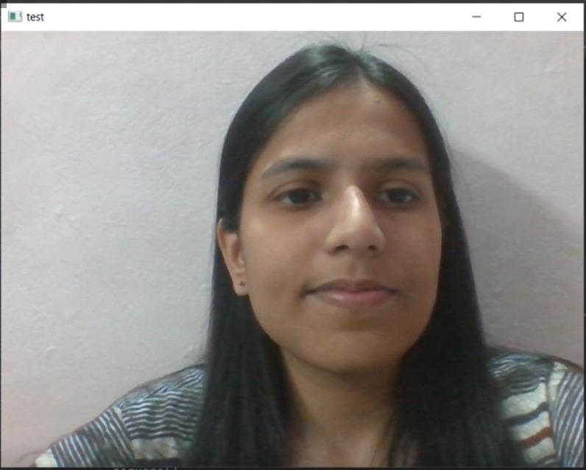
OUTPUT
STEPS:
1 2 3

Slide 32
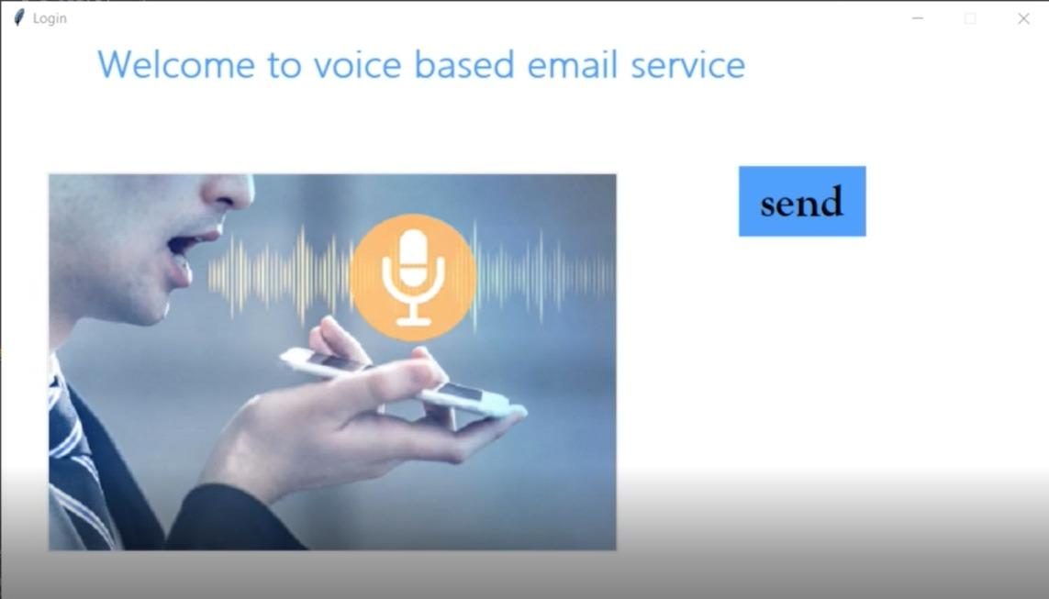
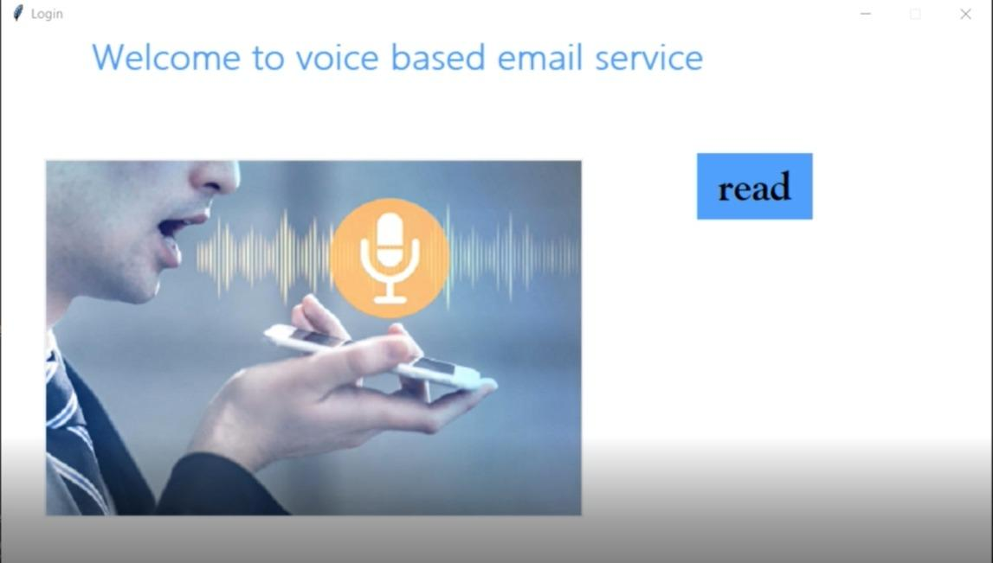
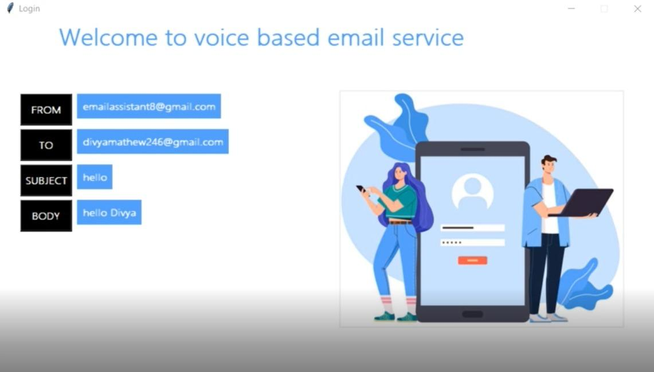
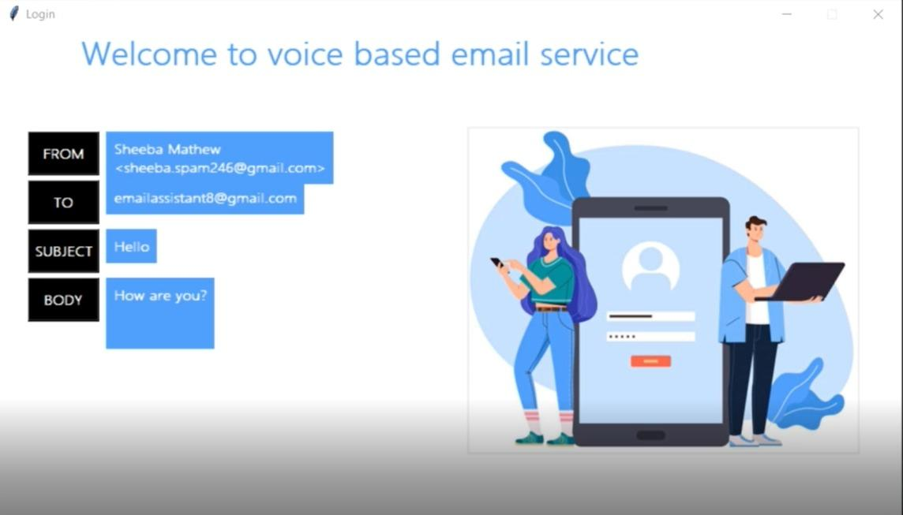
7
4
5
6

Slide 33

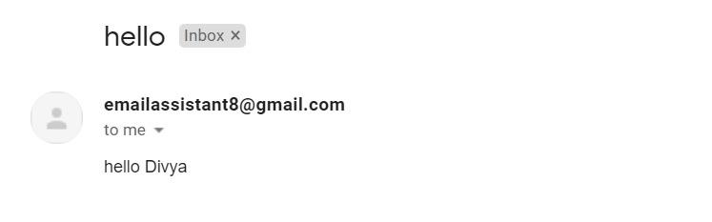
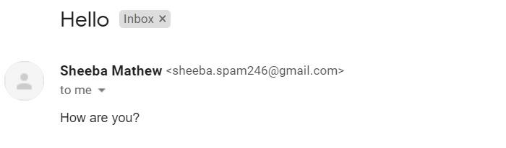
Demo Link: https://drive.google.com/file/d/1l-wQE0GmeX_I9UehuyhLpB4myE3ZYW2L/view?usp=sharing
8
9
10

Slide 34
CONCLUSION
A proposal tailored to the needs of blind or visually impaired has been offered
Allows to read and send mail without assistance
Use of specific terms
Advantage of a speech recognition programme to give an efficient voice input
Receiving unseen mails and generating a voice output with the sender's mail id, subject, and message was successful
Text-to-speech and speech-to-text modules, as well as implementing a chatbot for effective user-system communication
Register and login module was designed for users' convenience, as well as security and privacy to some level utilizing face recognition
How this project will help community???
A blind person can use this email system to access their correspondence quickly and simply
Visually impaired's dependency on others will be decreased
It is also beneficial to the crippled and illiterate
The system solves all of the challenges that the visually impaired confront

Slide 35

THANKS!

